Slide 1
Neural Network Graph Classifier
Patrick Spohr

Slide 2



Outline
Motivation – Why choose this project and what literature is there?
Objective – What do I want to accomplish?
Data – Where am I getting the data?
CIFAR-10 Images
Scraped Graphs
Generated Graphs
Methods – How do I achieve my objectives?
CNN, TensorFlow, and Python
Simple Graph Classifiers
Distribution Graph Classifiers
Results – Can the models accurately classify the images?
Simple Graph Classifiers
Distribution Graph Classifiers
Conclusion – What are my final thoughts and further research?

Slide 3

Motivation

Slide 4

Motivation
Graphs are everywhere…
And can depict many things…

Slide 5
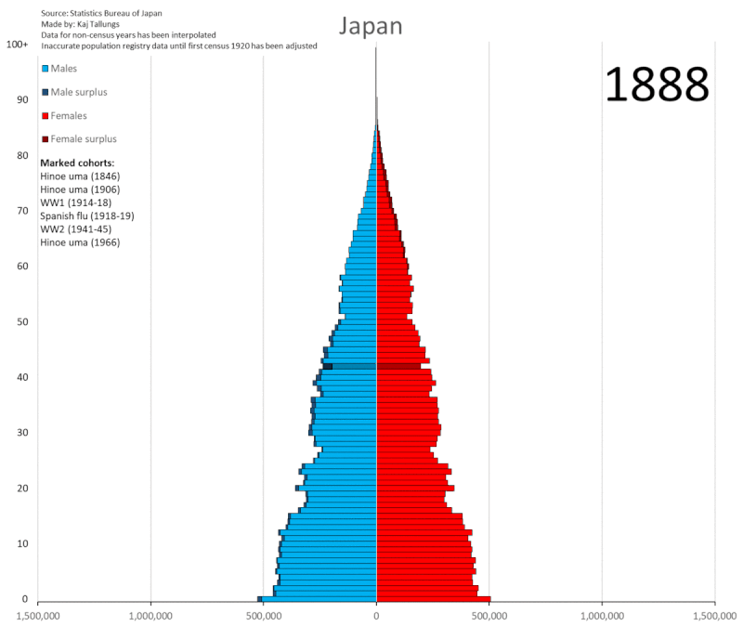
Motivation
I like graphs because like paintings, they too can tell a story.
By Kaj Tallungs - Own work, CC BY-SA 4.0, https://commons.wikimedia.org/w/index.php?curid=107393925

Slide 6
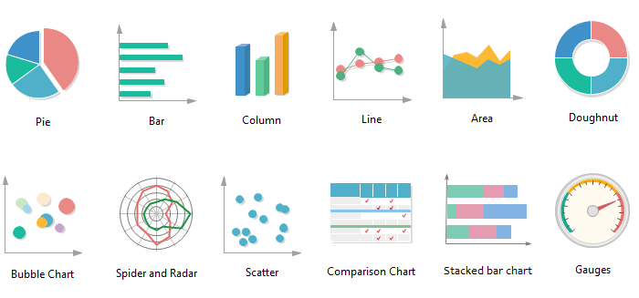
Motivation
Being able to quickly identify graphs is important as there are many to choose from.
https://medium.com/@Lynia_Li/as-you-know-there-are-many-types-of-charts-to-be-used-in-data-visualization-54da9b97092e

Slide 7
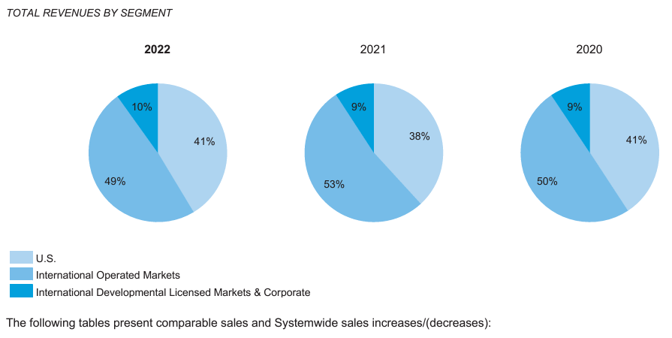
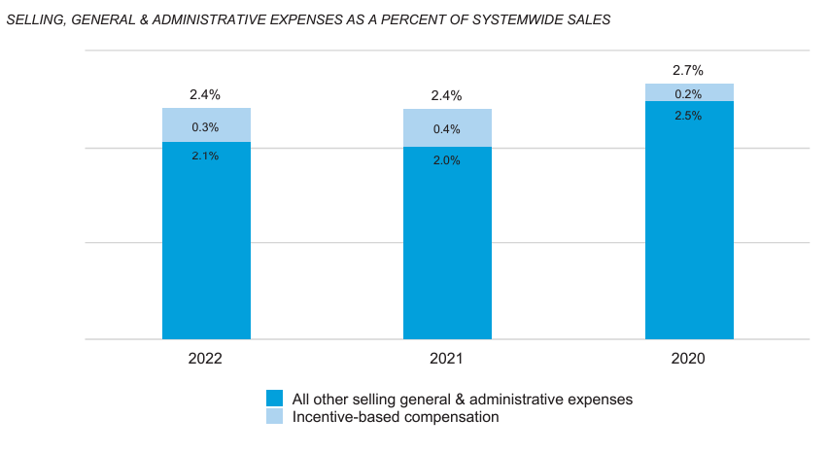

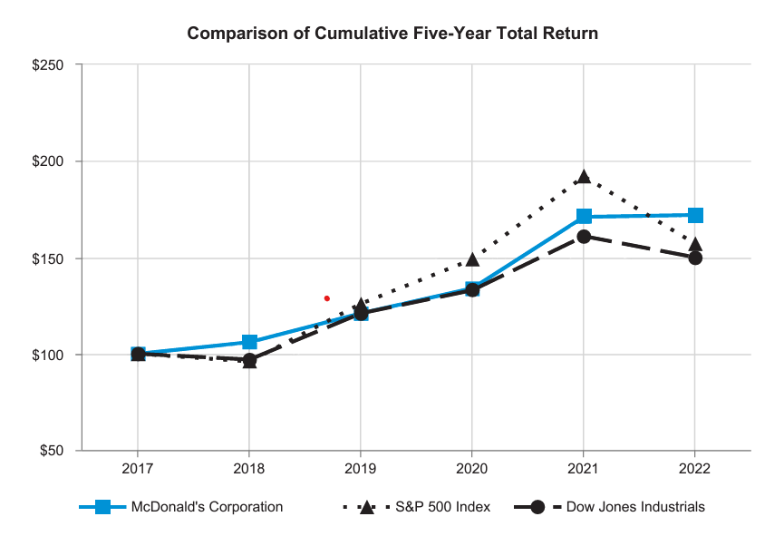
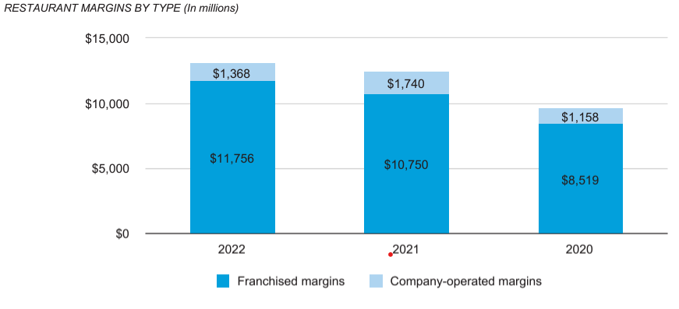
Motivation
Graphs make it quick and easy to interpret a large amount of information.
McDonald’s Annual 2022 Report has 73 pages and 8 graphs.
p. 16
p. 13
p. 25
p. 15
https://corporate.mcdonalds.com/content/dam/sites/corp/nfl/pdf/MCD_2023_Annual_Report.pdf

Slide 8
Motivation
What’s the possible use case of being able to identify graphs in McDonald’s Annual Report?
Identify
Locate
Organize
Is it a graph?
Where are they?
What type of graph?
Yes
Report
pie chart, bar chart…
Classify graph
Pages 13, 15, 16, 25
Organize and show
MY FOCUS

Slide 9
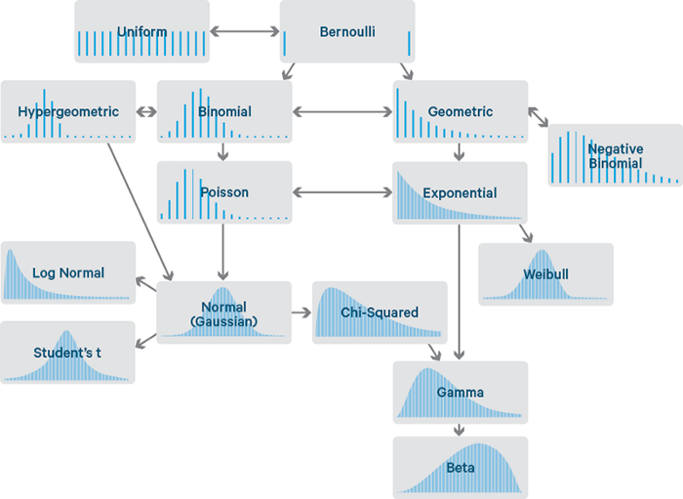
Motivation
Here I choose to classify the distributions in the graph since I didn’t find any similar projects.
https://miro.medium.com/v2/resize:fit:828/format:webp/1*nOMS0KgevT7YfqtfnhgXUg.png

Slide 10
Literature Review
Review of neural networks and image classification
While there are many image classification research, I didn’t find anything regarding the classification of graphs with probability distributions.
CS231n. (2023). (Stanford University) Retrieved January 2024, from Convolutional Neural Networks for Visual Recognition: https://cs231n.github.io/convolutional-networks/
O'Shea, K., & Nash, R. (2015). An Introduction to Convolutional Neural Networks. Aberystwyth University. Retrieved from https://arxiv.org/abs/1511.08458

Slide 11
Objective

Slide 12
Objective
Goals of the Project
First
Identify a graph from other images.
Second
Classify the graph.
Distributions
Normal
Log-Normal
Exponential
Uniform
MY FOCUS
Identify
Is it a graph?
Yes
Classify Graph

Slide 13
Objective
Goals of the Project
Workflow of the project...
Get Data
Graph Classifier
Distribution Classifier
Model Evaluation
Get 1000s of graphs of different types and distributions
Get 1000s of natural images for graph classifier
Create first model to identify whether an image is a graph or not
Create second model to classify graphs based on their probability distributions
Optimize models and check validation accuracy

Slide 14


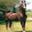
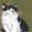
CIFAR-10
Objective
Hurdles to Overcome
Natural Images Data
car
airplane
horse
cat
Getting natural images is easy because of quantity and quality of sources.
https://www.cs.toronto.edu/~kriz/cifar.html

Slide 15
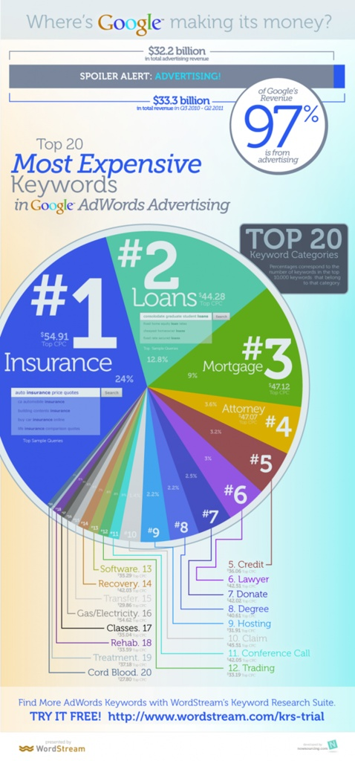
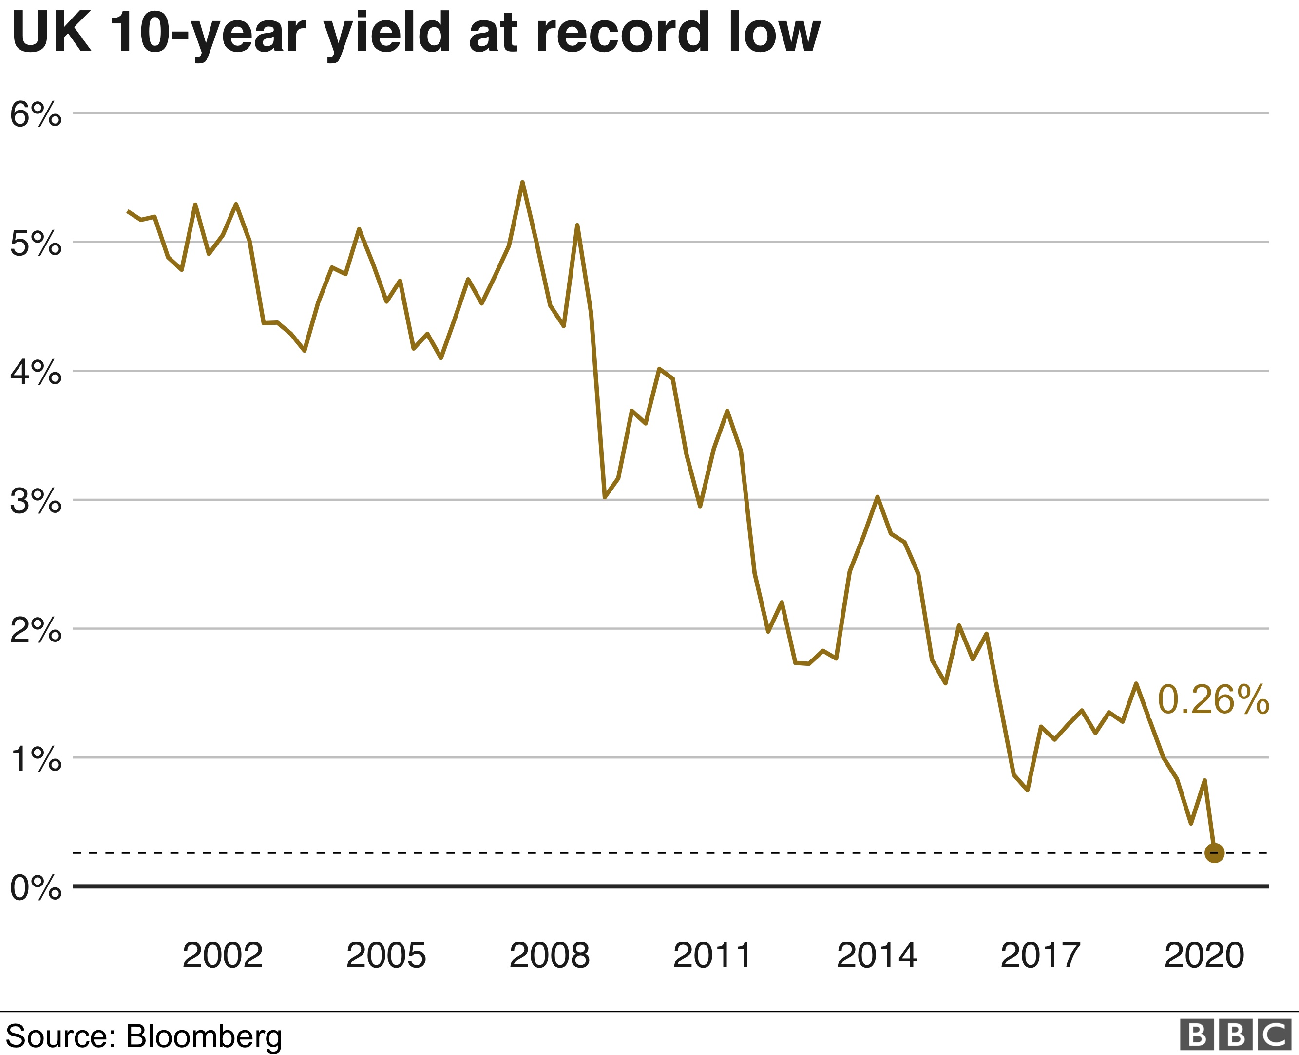
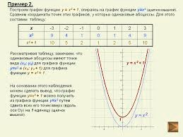
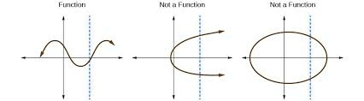
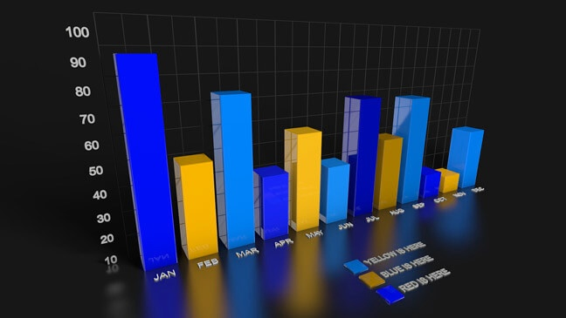
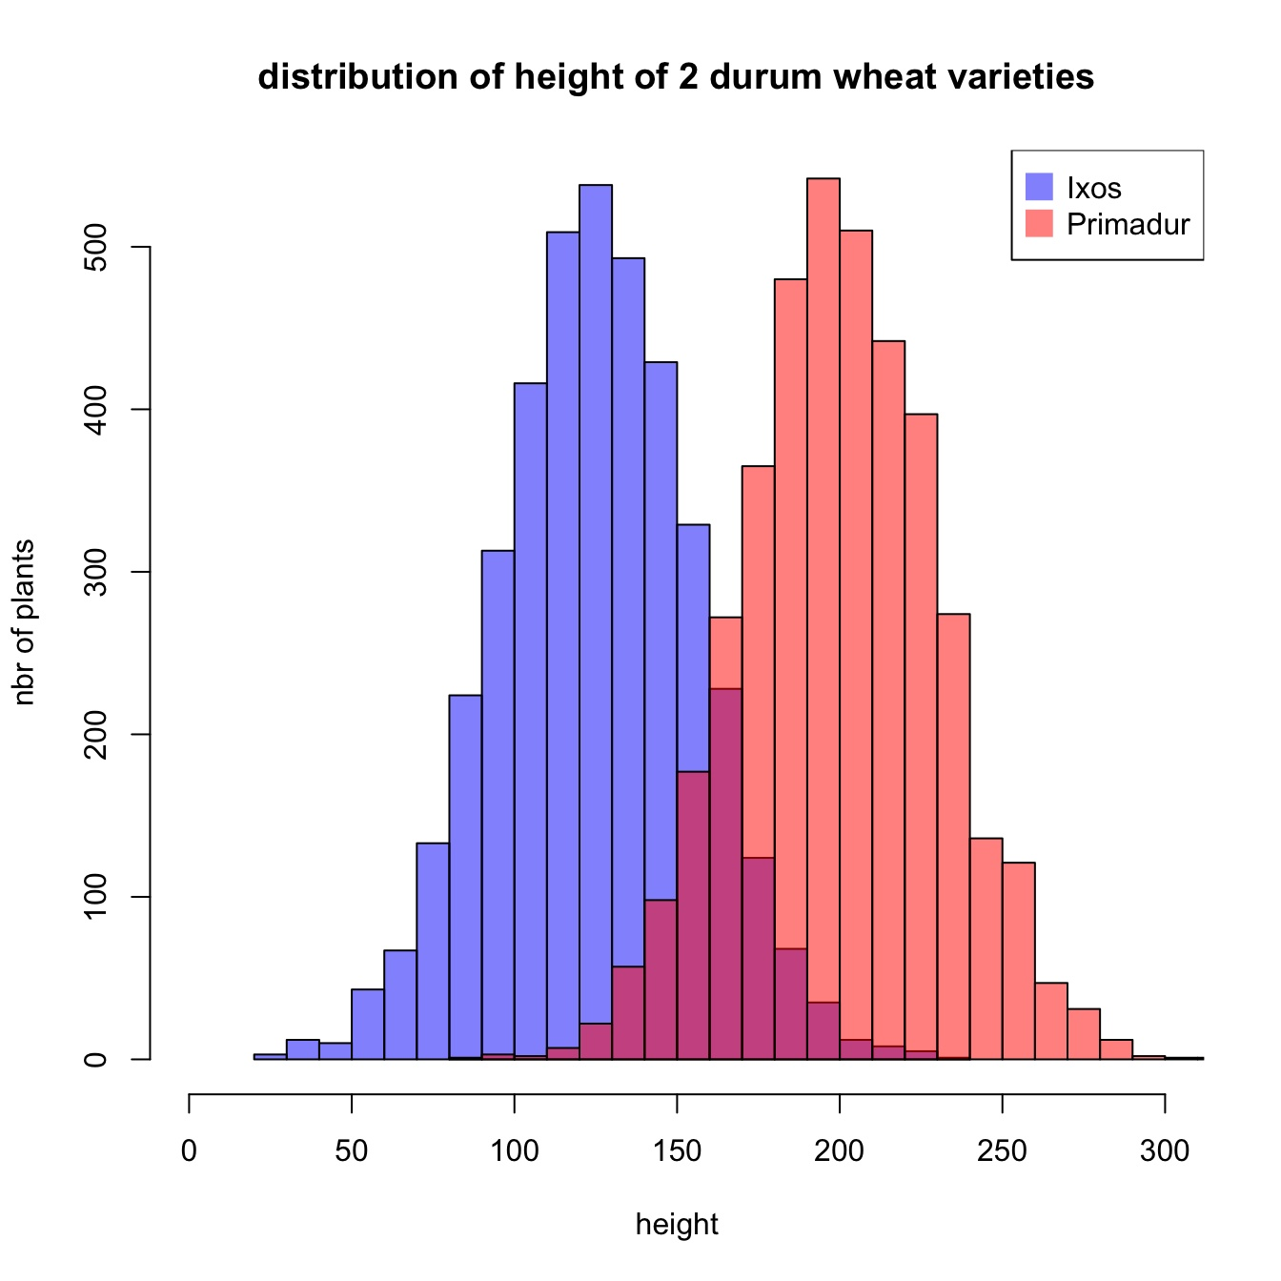
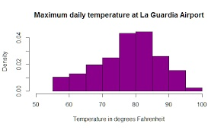
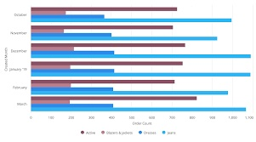
Objective
Hurdles to Overcome
Where can I get the graph images?
kaggle.com
https://www.kaggle.com/datasets/sunedition/graphs-dataset

Slide 16
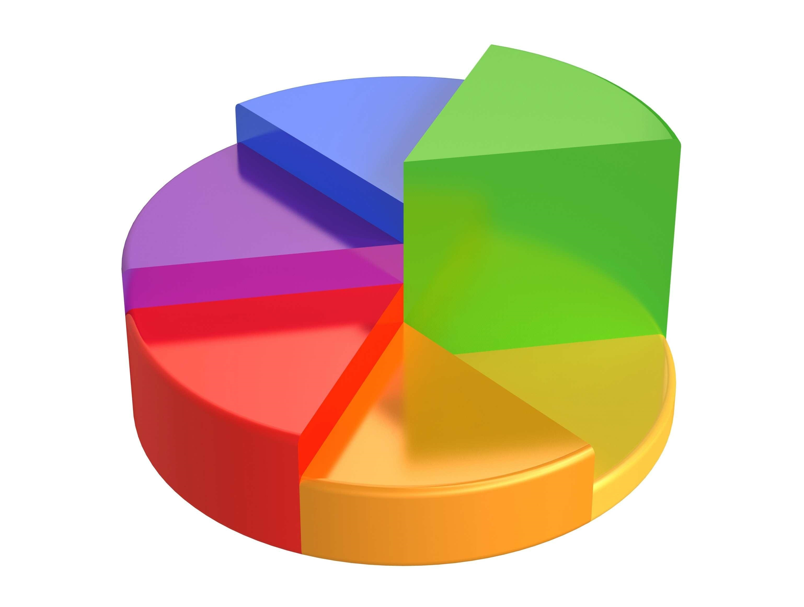
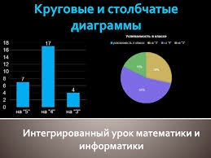
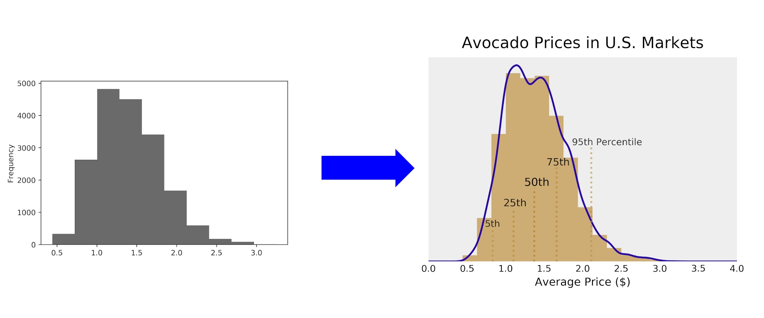
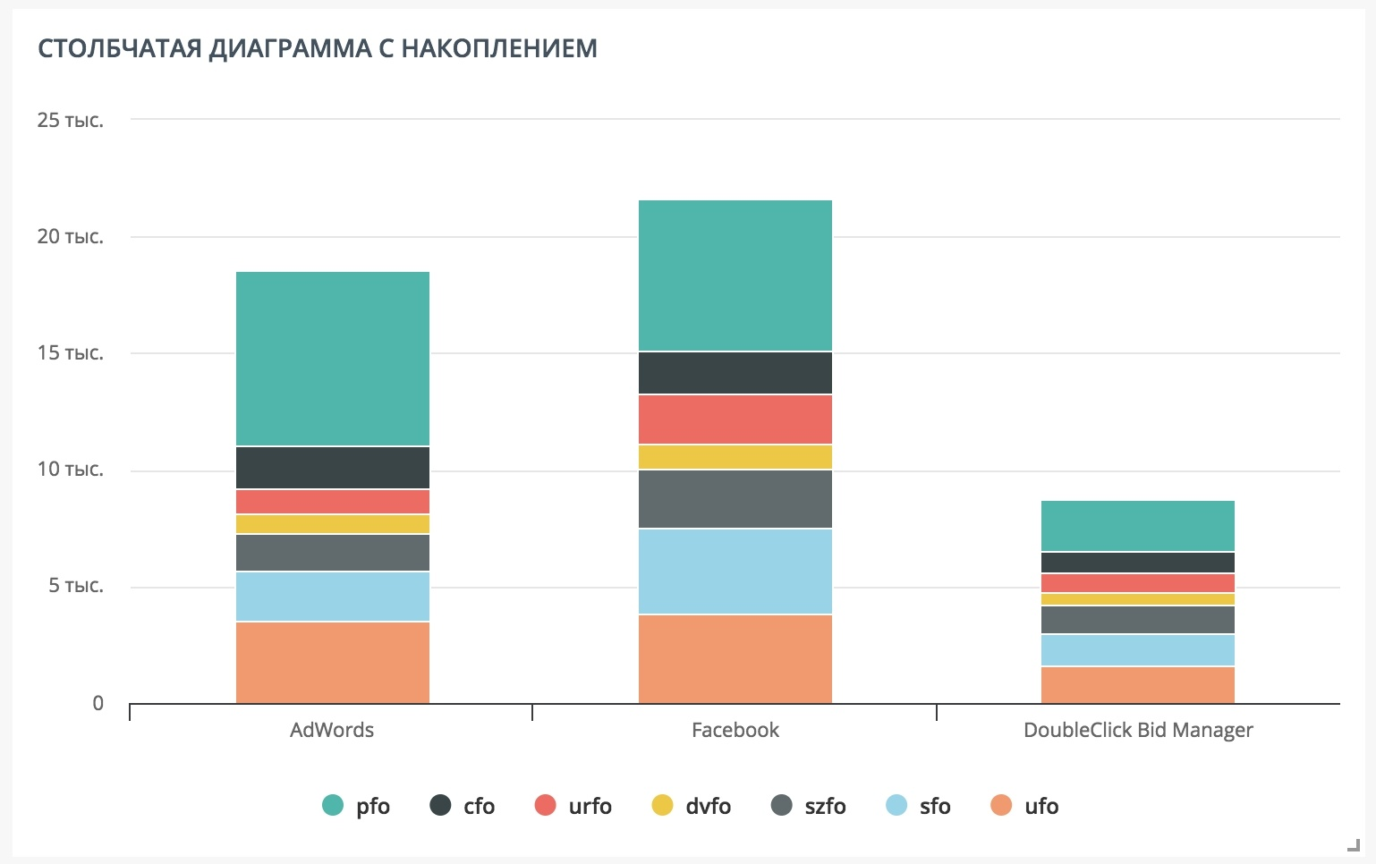
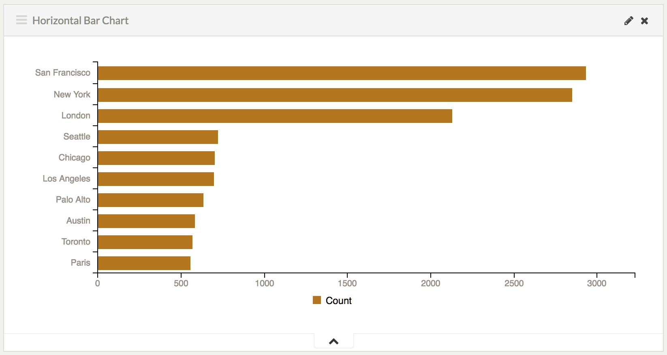
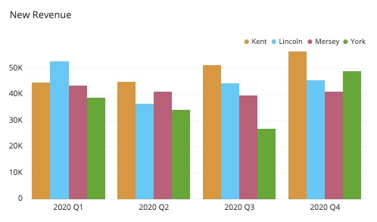
Objective
How to determine the type of a graph?
Hurdles to Overcome
Bar chart, line chart, histogram, and log-normal distribution
Two charts in one image
“Graph-like” images
Bar Chart Types
Stacked bar chart
Horizontal bar chart
Vertical bar chart
https://www.kaggle.com/datasets/sunedition/graphs-dataset

Slide 17
Objective
Hurdles to Overcome
The Biggest Hurdle…
Could not find suitable dataset with probability distribution graphs.
# Solution One - Scraped
Scrape the graphs from a website, but I would run into the issue of where to scrape and how to label them time efficiently.
# Solution Two - Generated
Use a graphing library to generate randomized graphs.
This is the most time effective solution that will lead to hopefully similar results.

Slide 18
Data

Slide 19
Data
3 Data Sources
CIFAR-10
Generated Graphs
Natural images of different types of objects, animals, and people
Graphs with different probability distributions.
Created using a language library.
https://www.cs.toronto.edu/~kriz/cifar.html
Scraped Graphs (SunEdition)
Graph dataset scraped from various sources which weren’t stated.
https://www.kaggle.com/datasets/sunedition/graphs-dataset

Slide 20
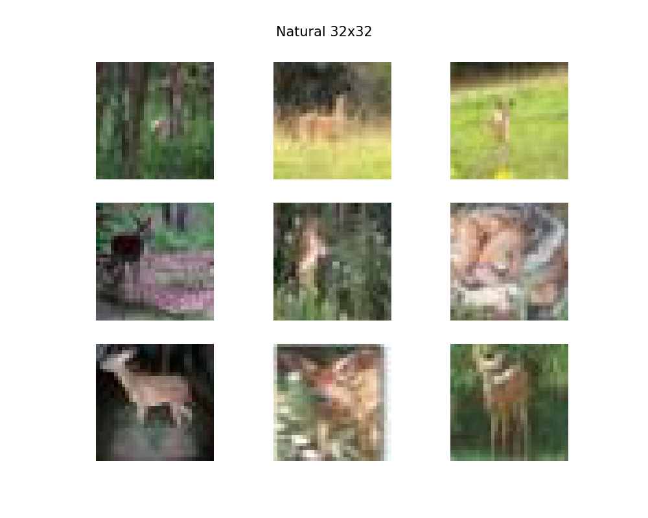
Data
CIFAR-10 Images
CIFAR-10 Overview (CIFAR)
Canadian Institute For Advanced Research
Count – 60,000
Dimensions – 32x32
Format – flat NumPy array
Shape – (3072,)
10 Classes – airplane, automobile, bird, cat, deer, dog, frog, horse, ship, and truck
Updated
Count – 10,000 (first batch)
Dimensions – 32x32
Format – JPG
Shape – (32, 32, 3)
10 Classes – airplane, automobile, bird, cat, deer, dog, frog, horse, ship, and truck

Slide 21
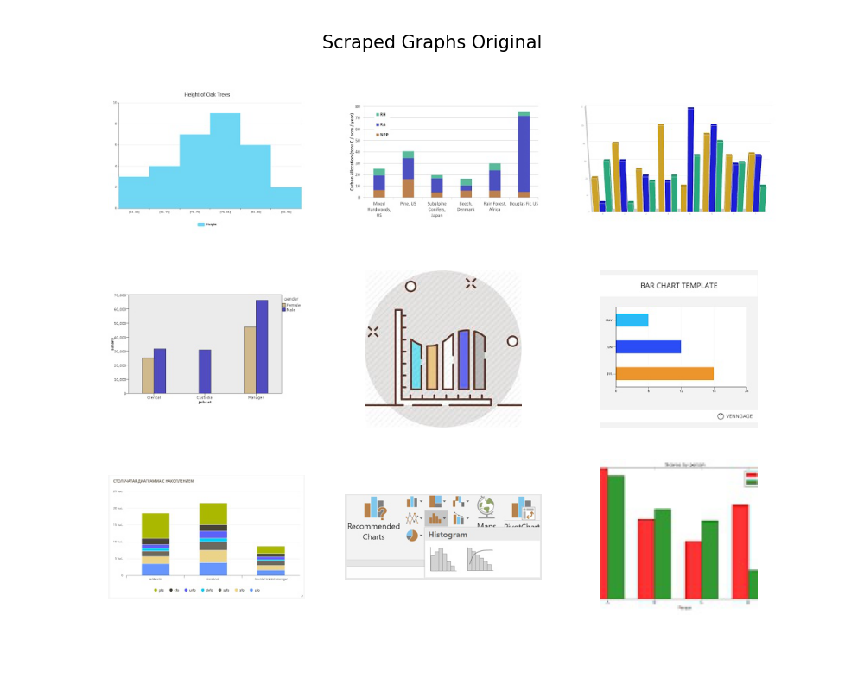
Data
Scraped Graphs
Scraped Overview (SCP)
https://www.kaggle.com/sunedition
Count – 15,786
Dimensions – various
Format - JPG
8 Classes – just image, bar chart, diagram, flow chart, graph, growth chart, pie chart, table
Updated
Count – 7,753
Dimensions – 32x32
Format - JPG
4 Classes – bar, diagram, graph, pie

Slide 22
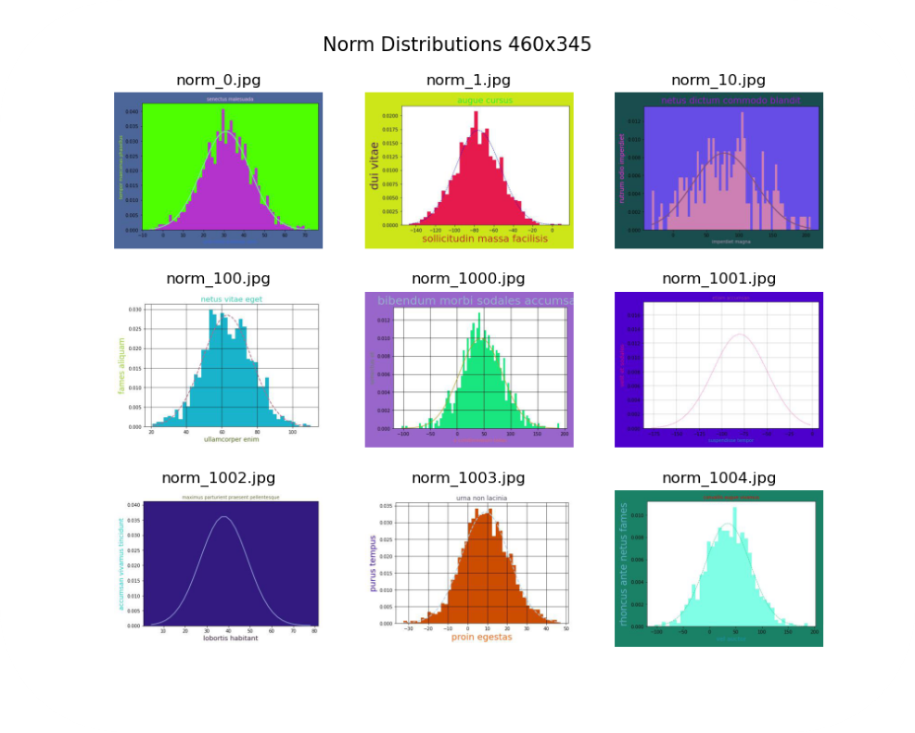
Data
Generated Graphs
Generated Overview (GEN)
My own dataset
Count – 8,000
Dimensions – 460x345
Format - JPG
4 Classes – norm, lognorm, exp, unif
norm: normal distribution
lognorm: log-normal distribution
exp: exponential distribution
unif: uniform distribution
Updated
Dimensions – 32x32, 115x86, 153x115

Slide 23
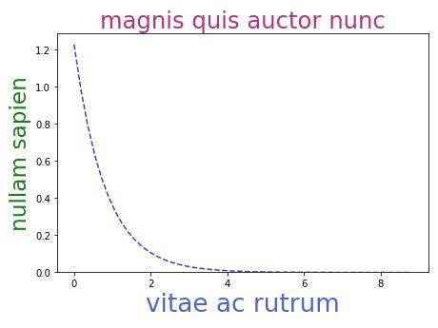
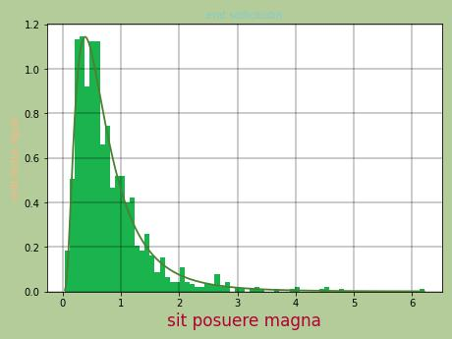
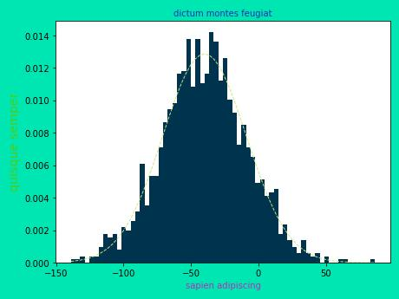
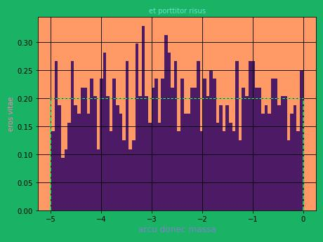
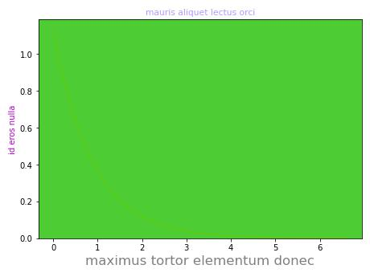
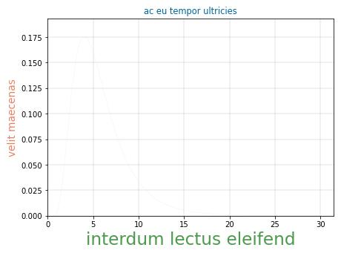
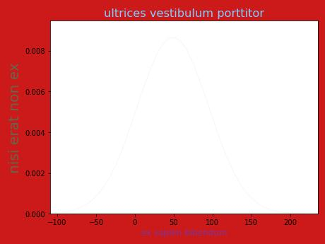
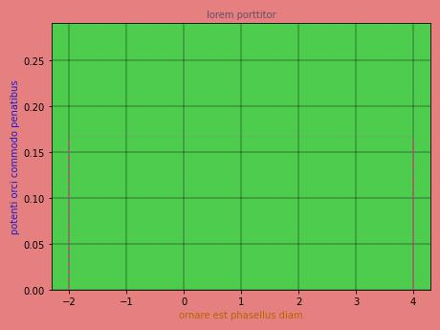
Nice vs dud Graphs
Generated Graphs
exp_146.jpg
lognorm_287.jpg
norm_226.jpg
unif_1144.jpg
exp_31.jpg
lognorm_759.jpg
norm_1506.jpg
unif_8.jpg

Slide 24
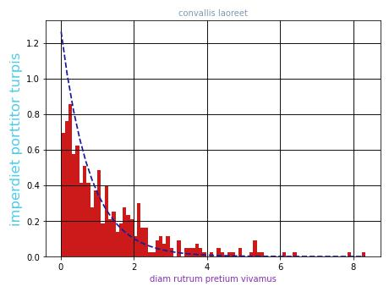
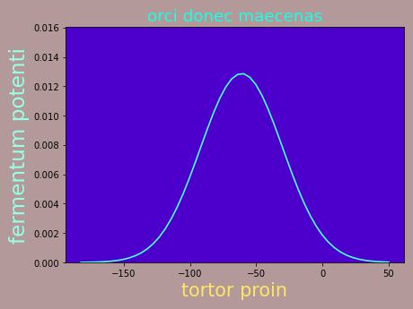
Methods
Generated Graphs
Generated Graph Design
exp_199.jpg
Randomized Design
Color – RGB (0-1 for matplotlib)
Fig and Face – RGB but biased to white
Histogram – Yes/No
Line – Yes/No
Line Style – Solid/Dash
Text – random lorum ipsum
Text Size – random
Density function parameters – random
norm_796.jpg
https://github.com/p-spohr/NN-Graph-Classifier/tree/main/graph_generators

Slide 25











Methods
Generated Graphs
Density Functions
Normal Distribution
Log-Normal Distribution
$$f\left(x\right)=\frac{1}{σ\sqrt{2π}}e^{−\frac{1}{2}{\left(\frac{x−μ}{σ}\right)}^{2}}$$
$$f\left(x\right)=\frac{1}{xσ\sqrt{2π}}e^{−\frac{1}{2}{\left(\frac{log⁡(x)−μ}{σ}\right)}^{2}}$$
$$μ∈ ℝ$$
$$μ∈ ℝ$$
$$σ∈ℝ_{+}$$
$$σ∈ℝ_{+}$$
Exponential Distribution
Uniform Distribution
$$f\left(x\right)={λe}^{−λx}$$
$$λ∈ℝ_{+}$$
$$f\left(x\right)=\frac{1}{b−a}$$
$$a,b ∈ ℝ$$
$$a <b$$

Slide 26
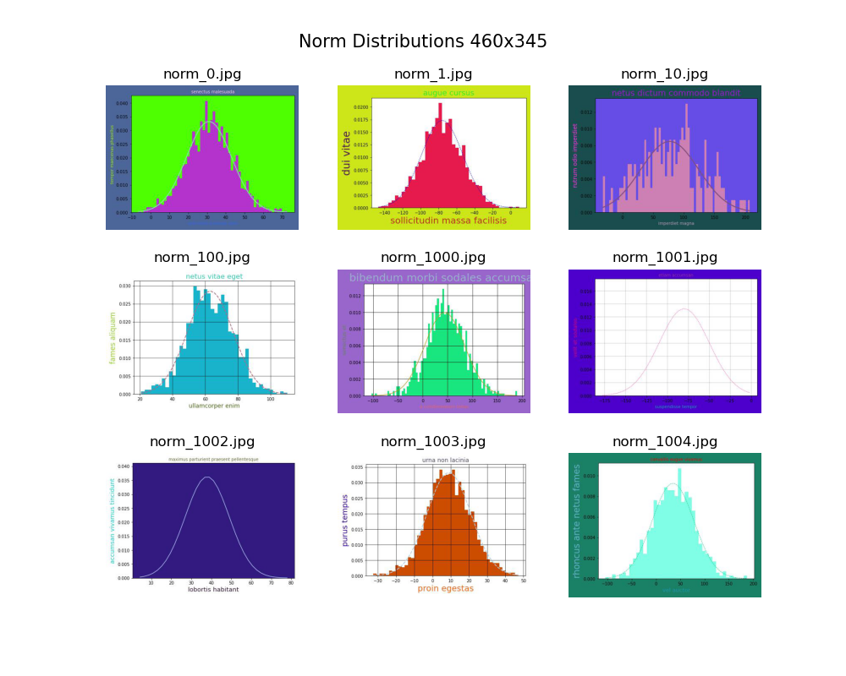


Methods
Distribution Graph Classifiers
Generated Graphs Overview
Different Image Dimensions
subfolder
Original 460x345
153x115
115x186

Slide 27
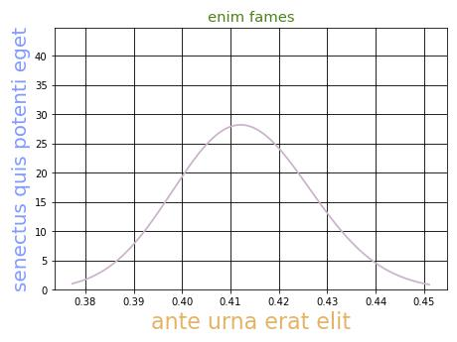
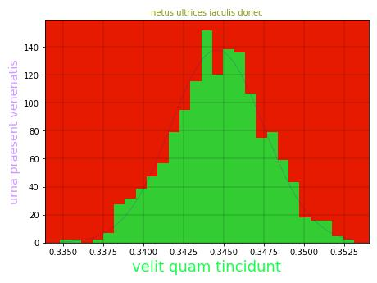
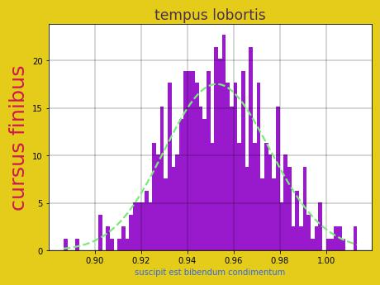
Methods
Generated Graphs
Pre-identifying possible misclassifications
Log-Normal vs. Normal Graphs
Which graph has the log-normal distribution?

Slide 28
Methods

Slide 29
Methods
Overview of how the goals were accomplished
Reviewed literature available on ANNs and CNNs
Familiarized myself with TensorFlow, Keras, and Pillow (Python library for images)
Found natural images (CIFAR) and scraped images (SCP)
Generated graph dataset (GEN) in 32x32, 115x86, 153x115
Trained Simple Graph Classifiers using CIFAR, SCP, GEN datasets
Evaluated models using untrained images
Trained Distribution Graph Classifiers using 32x32, 115x86, 153x115
Evaluated models to see where they misclassified
Tested untrained images with 153x115

Slide 30
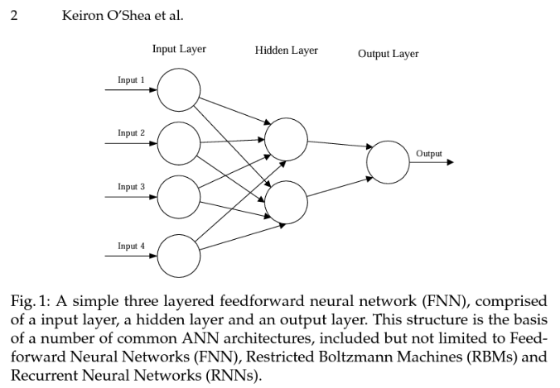
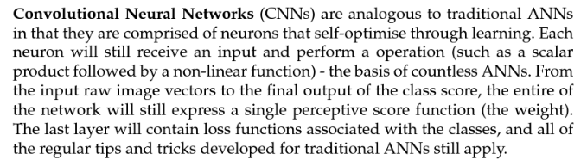
Methods
CNN, TensorFlow, and Python
Artificial Neural Networks
Which machine learning method will I use?
ANN and CNN
The only notable difference between CNNs (convolutional neural networks) and ANNs (artificial neural networks) is that they are mostly employed in the field of pattern recognition with images. CNNs enable encoded image-specific features into the architecture, making the net work more suited for image-focused tasks while also reduction the parameters required to set up the model.
https://www.researchgate.net/publication/285164623_An_Introduction_to_Convolutional_Neural_Networks

Slide 31
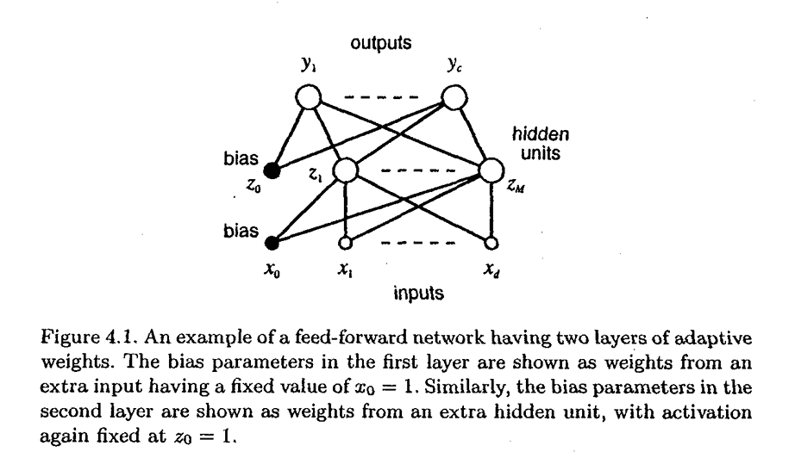
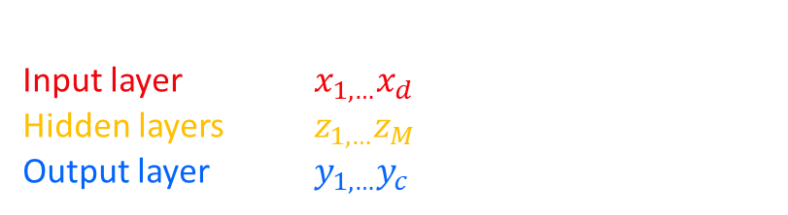
Methods
Feed-Forward Neural Networks
„We shall view feed-forward neural networks as providing a general framework for representing non-linear functional mappings between a set of input variables and a set of output variables.“
[Bishop, 117]
Three main parts for a neural network:
Input layer $x_{1,…}x_{d}$
Hidden layers $z_{1,…}z_{M}$
Output layer $y_{1,…}y_{c}$

Slide 32






Methods
Feed-Forward ANN
[Bishop, 116-119]
Output of the hidden-unit
Output of the network
$$a_{j}=\sum_{i=1}^{d}{w_{ji}^{\left(1\right)}x_{i}+w_{j0}^{\left(1\right)}}$$
$$a_{k}=\sum_{j=1}^{M}{w_{kj}^{\left(2\right)}z_{i}+w_{k0}^{\left(2\right)}}$$
d: Inputs
M: Hidden-Units
$w_{ji}^{\left(1\right)}$ weight in first layer
$w_{j0}^{\left(1\right)}$ bias for hidden unit j
Complete function for figure 4.1
$\tilde{g}\left(∙\right)$ activation function for the output units
$$a_{k}=\tilde{g}\left(\sum_{j=1}^{M}{w_{kj}^{\left(2\right)}g\left(\sum_{i=1}^{d}{w_{ji}^{\left(1\right)}x_{i}}\right)}\right)$$
$g\left(∙\right)$ activation function
$$z_{j}=g(a_{j})$$
$$y_{k}=\tilde{g}(a_{k})$$
kth output unit

Slide 33

Methods
CNN, TensorFlow, and Python
Convolutional Neural Network
Layer by layer overview of using CNN to classify a car
https://cs231n.github.io/convolutional-networks/

Slide 34
Methods
CNN, TensorFlow, and Python
Convolutional Neural Network
Layers of CNNs:
Input layer – take pixel values of image (HEIGHT, WIDTH, RGB)
Convolutional layer – determines the output of neurons of which are connected to local regions of the input through the calculation of the scalar product between their weights and the region connected to input volume
Rectified linear unit (ReLu) – aims to apply an ‘elementwise’ activation function such as sigmoid to the output of the activation produced by the previous layer
Pooling layer – downsampling along the spatial dimensionality of the given input, reducing number of parameters within that activation
Fully-connected layers (output layer) – performs the same duties found in standard ANNs and attempts to produce class scores from the activations to be used for classification
https://www.researchgate.net/publication/285164623_An_Introduction_to_Convolutional_Neural_Networks

Slide 35
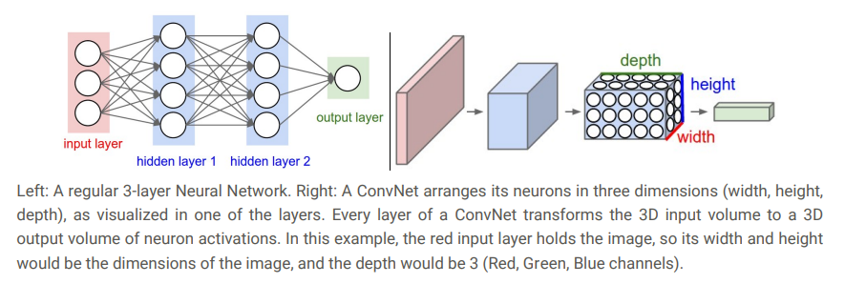
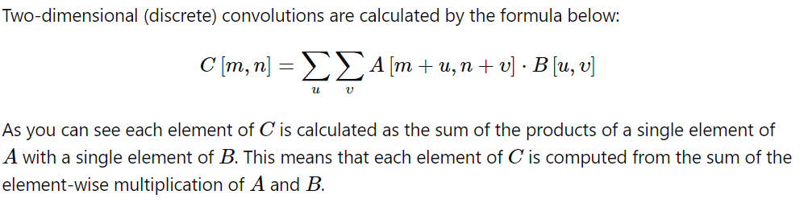
Methods
CNN, TensorFlow, and Python
Convolutional Layer
The original image gets transformed layer by layer from the original pixel values to the final class scores.
Unlike standard ANNs, the neurons within any given layer will only connect to a small region of the layer preceding it.
The final output layer for CIFAR-10 would have dimensions of 1x1x10 because by the end of the architecture we will reduce the full image into a single vector of class scores, arranged along the depth dimension.
The next important thing is the filter applied to the image.
https://stats.stackexchange.com/questions/335321/in-a-convolutional-neural-network-cnn-when-convolving-the-image-is-the-opera
https://cs231n.github.io/convolutional-networks/

Slide 36
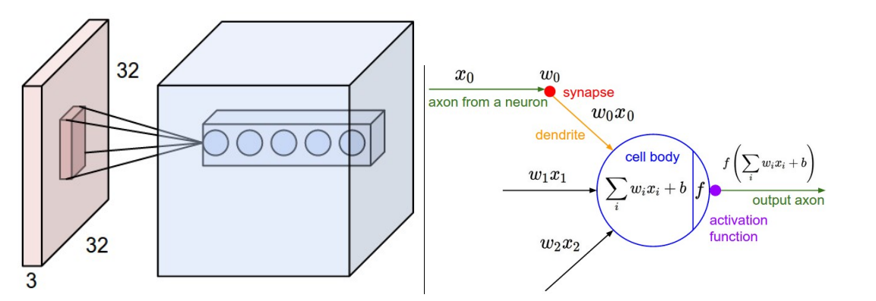
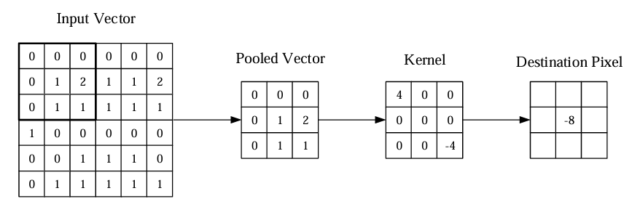


Methods
CNN, TensorFlow, and Python
Convolutional Layer
The convolutional layer will determine the output of neurons of which are connected to local regions of the input through the calculation of the scalar product between their weights and the region connected to the input volume.
Backpropagation: The backward pass for a convolution operation (for both the data and the weights) is also a convolution (but with spatially-flipped filters).
Dot Product
a = 1st vector
b = 2nd vector
n = dimension of the vector space
$a_{i}$= component of vector a
$b_{i}$= component of vector b
$$a∙b=\sum_{i=1}^{n}{a_{i}b_{i}}$$
https://www.researchgate.net/publication/285164623_An_Introduction_to_Convolutional_Neural_Networks

Slide 37
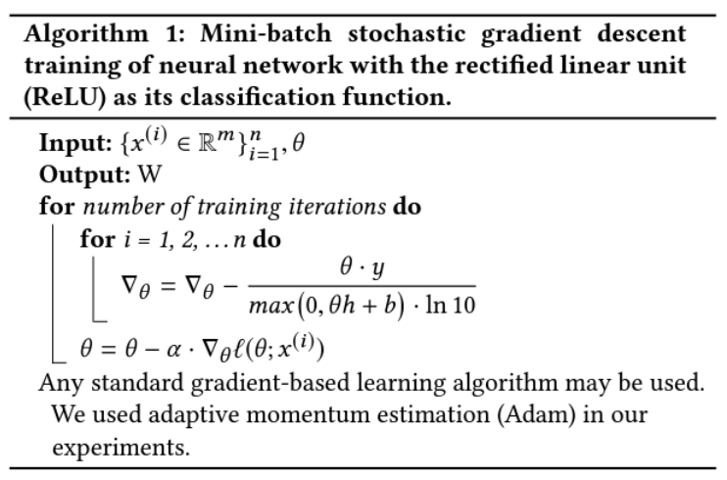
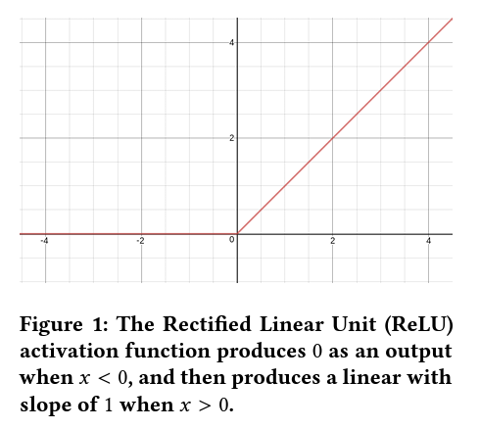

Methods
CNN, TensorFlow, and Python
Rectified Linear Units (ReLU)
f(x) = max(0,x)
Let the input be replaced by the penultimate activation output h
$$\frac{∂ℓ(θ)}{∂h}=−\frac{θ∙y}{\max\left(0,θh+b\right)∙ln10}$$
https://arxiv.org/pdf/1803.08375

Slide 38
Methods
CNN, TensorFlow, and Python
Max Pooling
A common approach to addressing this problem from signal processing is called down sampling. This is where a lower resolution version of an input signal is created that still contains the large or important structural elements, without the fine detail that may not be as useful to the task.
A limitation of the feature map output of convolutional layers is that they record the precise position of features in the input. This means that small movements in the position of the feature in the input image will result in a different feature map. This can happen with re-cropping, rotation, shifting, and other minor changes to the input image.
Maximum pooling, or max pooling, is a pooling operation that calculates the maximum, or largest, value in each patch of each feature map.
https://machinelearningmastery.com/pooling-layers-for-convolutional-neural-networks/

Slide 39

Methods
CNN, TensorFlow, and Python
Adam Optimizer
“…an algorithm for first-order gradient-based optimization of stochastic objective functions, based on adaptive estimates of lower-order moments.”
Pros:
only requires first-order gradients
little memory requirement
https://arxiv.org/abs/1412.6980

Slide 40


Methods
CNN, TensorFlow, and Python
Sparse Categorical Cross-Entropy
Use this cross-entropy loss function when there are two or more label classes.
Cross-Entropy =
(binary classification)
$$−(y∙\log\left(p\right)+\left(1−y\right)\log\left(1−p\right))$$
$$−\sum_{c=1}^{M}{y_{o,c}∙log⁡(p_{o,c})}$$
Cross-Entropy =
(classes > 2)
M: number of classes
y: binary indicator if class label c is the correct classification for observation o
p: predicted probability observation o is of class c

Slide 41


TensorFlow + Keras API
Methods
CNN, TensorFlow, and Python
TensorFlow – end-to-end platform for building ML models
Keras – deep learning API written in Python (compatible with TensorFlow)
https://www.tensorflow.org/api_docs/python/tf
https://keras.io/api/

Slide 42




Python + libraries
Methods
CNN, TensorFlow, and Python
NumPy – math + ndarray + random
Pandas – data handling
Matplotlib – graphing
Pillow – image processing
(TensorFlow returns PIL.Image)
https://numpy.org/doc/stable/reference/index.html
https://matplotlib.org/stable/index.html
https://pandas.pydata.org/docs/reference/index.html
https://pillow.readthedocs.io/en/stable/

Slide 43
Library Versions
Methods
CNN, TensorFlow, and Python
Other Programs Used
python 3.10.13
tensorflow 2.10.0
numpy 1.26.0
pandas 2.1.1
matplotlib 3.8.0
pillow 10.0.1
Visual Studio Code (code editor)
Anaconda (Python environments)
Jupyter Notebook (interactive code)

Slide 44
Methods
CNN, TensorFlow, and Python
What is an image to a computer?

Slide 45
Methods
CNN, TensorFlow, and Python
Dimensions and RGB

Slide 46
Methods
CNN, TensorFlow, and Python
Image Quiz

Slide 47
Methods
Simple Graph Classifiers
CIFAR: natural images
Total = 10000
SCP: scraped graphs (SunEdition)
Total = 7753
GEN: generated graphs
Total = 8000
1: Model 1
CIFAR_SCP_1
x = 32x32 images
y = [graph, natural]
Total = 17753
Train = 14203
Val = 3550
GEN_SCP_1
x = 32x32 images
y = [generated, scraped]
Total = 15753
Train = 12603
Val = 3150
CIFAR_GEN_1
x = 32x32 images
y = [graph, natural]
Total = 18000
Train = 14400
Val = 3600
CIFAR_GEN_SCP_1
x = 32x32 images
y = [generated, natural, scraped]
Total = 25753
Train = 20603
Val = 5150
https://github.com/p-spohr/NN-Graph-Classifier/tree/main/classifiers/simple_graph_classifiers

Slide 48

Methods
Simple Graph Classifiers
1: Model 1
Same model for simple graph classifiers and distribution graph classifiers.
"same" results in padding with zeros evenly to the left/right or up/down of the input.

Slide 49

Methods
CIFAR_GEN_1
Image examples
Simple Graph Classifiers
Input layer := x = (32, 32, 32, 3)
y = graph
y = natural

Slide 50


Load image datasets
Methods
Simple Graph Classifiers
CIFAR_SCP_1 & CIFAR_GEN_1
tf.keras.utils.image_dataset_from_directory(
directory,
labels='inferred’, # subfolder names
label_mode='int',
class_names=None,
color_mode='rgb’, # jpg has no alpha
batch_size=32,
image_size=(32, 32), # (height, width)
shuffle=True,
seed=None,
validation_split=None, # 0-1 for validation
subset=‘both’, # ‘both’ returns (‘train’, ‘val’)
interpolation='bilinear',
follow_links=False,
crop_to_aspect_ratio=False,
**kwargs
)
CIFAR_GEN_SCP_1
https://www.tensorflow.org/api_docs/python/tf/keras/utils/image_dataset_from_directory

Slide 51




Methods
Simple Graph Classifiers
Code Steps Overview
Similar steps for all models except the datasets and targets are different
1) Initialize constant parameters and directory path
2) Get dataset from directory path
3) Build model
4) Compile and fit model to data
https://github.com/p-spohr/NN-Graph-Classifier/blob/main/classifiers/simple_graph_classifiers/CIFAR_GEN_1.py

Slide 52
CIFAR_GEN_1 Summary
Model: "sequential"
Layer (type) Output Shape Param #
=================================================================
rescaling (Rescaling) (None, 32, 32, 3) 0
conv2d (Conv2D) (None, 32, 32, 16) 448
max_pooling2d (MaxPooling2D (None, 16, 16, 16) 0
)
conv2d_1 (Conv2D) (None, 16, 16, 32) 4640
max_pooling2d_1 (MaxPooling (None, 8, 8, 32) 0
2D)
conv2d_2 (Conv2D) (None, 8, 8, 64) 18496
max_pooling2d_2 (MaxPooling (None, 4, 4, 64) 0
2D)
flatten (Flatten) (None, 1024) 0
dense (Dense) (None, 128) 131200
dense_1 (Dense) (None, 2) 258
=================================================================
Total params: 155,042
Trainable params: 155,042
Non-trainable params: 0
_________________________________________________________________

Slide 53
Methods
Distribution Graph Classifiers
DIST = distribution classifier
*WIDTH x HEIGHT = dimensions of image
1 = Model 1
Input
DIST_32x32_1
x = 32x32 images
Total = 8000
Train = 6400
Val = 1600
DIST_115x86_1
x = 115x86 images
y = [exp, lognorm, norm, unif]
DIST_153x115
x = 153x115 images
*IMPORTANT: dimensions are reversed in TensorFlow
input_shape = (HEIGHT, WIDTH)
https://github.com/p-spohr/NN-Graph-Classifier/tree/main/classifiers/distribution_graph_classifiers

Slide 54
Results

Slide 55
Results Overview
Simple Graph Classifiers
Distribution Graph Classifiers
CIFAR_SCP_1
CIFAR_GEN_1
GEN_SCP_1
CIFAR_GEN_SCP_1
DIST_32x32_1
DIST_115x86_1
DIST_153x115_1

Slide 56
Simple graph classifiers
Results

Slide 57

CIFAR_SCP_1
Natural Images and Scraped Graphs
97.55%
High validation accuracy after 3 epochs

Slide 58

CIFAR_GEN_1
Natural Images and Generated Graphs (my graphs)
99.89%
Even my generated graphs can be classified accurately

Slide 59

GEN_SCP_1
Generated Graphs and Scraped Graphs
99.21%
This was surprising! The generated graphs are quite distinguishable from the scraped graphs

Slide 60

CIFAR_GEN_SCP_1
Natural Images, Generated Graphs, and Scraped Graphs
98.12%
For good measure –a model to classify all three

Slide 61
Evaluations
Can the models predict if an image from the other graph dataset is a graph or not?
Generated Graphs in CIFAR_SCP_1
Scraped Graphs in CIFAR_GEN_1
Prediction | Count
True (graph) | 6475
False (natural) | 1525
Prediction | Count
True (graph) | 2886
False (natural) | 4867
Accuracy: 80.9375%
Accuracy: 37.2243%
Best case is 100% accuracy
When graphs from the scraped dataset are put into the CIFAR_GEN_1, it predicts most of them are natural images.

Slide 62

Evaluations
What does this mean?
Graphs with a uniform distribution were most often labelled as a natural image.

Slide 63








Misclassification as natural
Misclassified Exp
exp_20
exp_202
exp_392
exp_730
Misclassified Lognorm
lognorm_237
lognorm_544
lornorm_918
lognorm_1344

Slide 64








Misclassification as natural
Misclassified Norm
norm_399
norm_695
norm_1185
norm_1929
Misclassified Unif
unif_18
unif_352
unif_763
unif_1436

Slide 65
Distribution graph classifiers
Results

Slide 66

DIST_32x32_1
Distribution Graphs of Dimension 32x32
79.25%
The model struggled more to classify the graphs, but still managed almost 80% validation accuracy after 10 epochs

Slide 67

DIST_115x86_1
Distribution Graphs of Dimension 115x86
93.00%
Increasing the quality of the image greatly increased accuracy

Slide 68

DIST_153x115_1
Distribution Graphs of Dimension 115x86
93.50%
Diminishing return in regards of image quality since the validation accuracy only improved by 0.5% to 93.5% from the 115x86 images.

Slide 69
Evaluation Overview
The model can’t consistently classify ~7% of the images when validating. What are the that are getting misclassified?
Accuracy is 96.5375% with a total of 270 misclassifications
Exp in DIST_153x115_1
Lognorm in DIST_153x115_1
Prediction | Count
True (exp) | 1851
False (other) | 149
Prediction | Count
True (lognorm) | 1925
False (other) | 75
Accuracy: 92.55%
Accuracy: 96.25%
Norm in DIST_153x115_1
Unif in DIST_153x115_1
Prediction | Count
True (norm) | 1960
False (other) | 40
Prediction | Count
True (unif) | 1994
False (other) | 6
Accuracy: 98.00%
Accuracy: 99.70%

Slide 70

Misclassifications
What does this mean?
Graphs with an exponential distribution were most often labelled incorrectly.

Slide 71




Deeper Dive

Slide 72

Misclassification Results csv
In order to understand the results better I created a CSV with relevant information.
Here is the misclassification of exponential distribution graphs as lognormal.
Ending prediction weights per class
Correct?
File name
Labeled based on max

Slide 73








Misclassification of Exp as Lognorm
Bonus: Exp as Unif
exp_313 = 9.7 prediction
exp_502 = 11.5
exp_578 = 9.5
exp_1782
exp_1142
exp_724 = 12.7
exp_883 = 11.2
exp_1021 = 10.6

Slide 74





Misclassification of Norm as Lognorm
norm_53 = 6.7 prediction
norm_193 = 8.9
norm_194 = 7.5
norm_1082 = 11.6

Slide 75





Misclassification of Lognorm as norm
lognorm_520 = 9.1 prediction
lognorm_710 = 11.5
lognorm_972 = 6.2
lognorm_1301 = 10.6

Slide 76





Misclassification of unif
unif_451 as lognorm
unif_466 as norm
unif_609 as exp
unif_642 as exp
Not very surprising that these graphs are labeled seemingly randomly since they are mostly blank.
But it is impressive that there are only 6 misclassified unif graphs considering the amount that look like these.

Slide 77

Final Test Evaluation
In order to truly evaluate my generated graphs and models, I needed to use graphs that were not used before.
Exp 20 (new scraped) + 1 (hand-drawn)
Lognorm 20 + 1
Norm 20 + 1
Unif 20 + 1
Test images in DIST_153x115_1
Prediction | Count
True | 52
False | 36
Accuracy: 59.091%
Most incorrectly classified graphs were misclassified as lognorm
Best case is 100% accuracy

Slide 78



Final Test Evaluation
Misclassified Exp Graphs
40% of exp graphs were misclassified as lognorm
exp_hand_0
Misclassified Lognorm Graphs
Only two misclassifications of lognorm graphs

Slide 79







Final Test Evaluation
Misclassified
norm_8
norm_11
norm_13
norm_15
norm_hand_0
True
Norm = 13.159
Lognorm = 8.398
Correctly Predicted

Slide 80

Final Test Evaluation
Misclassified Unif Graphs
It was surprising how 65% of unif graphs in the test dataset were misclassified as lognorm since the generated unif graphs were predicted so accurately.
Unif in DIST_153x115_1
Prediction | Count
True (unif) | 1994
False (other) | 6
Accuracy: 99.70%

Slide 81
Conclusion

Slide 82
Conclusion
Overall Goals Accomplished
can successfully identify graphs from natural images with greater than ~98% accuracy
can successfully identify graphs with different distribution types with ~93% accuracy
Some Surprising Results
scraped graphs in CIFAR_GEN_1 are misclassified as natural images ~63% of the time
This enforces my idea that many of the images in SCP were more ‘graph-like’ and not graphs
unif in DIST_153x115_1 were classified accurately ~99% of the time, but 20% of unif graphs in CIFAR_SCP_1 were misclassified as natural images
Graphs with the uniform distribution were very unique from the other distribution graphs but not very unique from natural images

Slide 83

More Preprocessing Considerations to Improve Results
Conclusion
tf.keras.layers.RandomBrightness()
tf.keras.layers.RandomContrast()
tf.keras.layers.RandomCrop()
tf.keras.layers.RandomFlip()
tf.keras.layers.RandomRotation()
model = tf.keras.Sequential([
layers.Rescaling(1./255,
# add more randomness to images after rescaling
])
https://www.tensorflow.org/api_docs/python/tf/image/random_brightness

Slide 84

Conclusion
Further Research and Improvement
Change model structure
Use more images to train models
Improve generated graphs
Add more distributions
Use entire reports as input and identify pages with graphs on them
https://www.researchgate.net/publication/285164623_An_Introduction_to_Convolutional_Neural_Networks

Slide 85

DIST_32x32_2
Distribution Graphs of Dimension 32x32
Epochs = 20
82.62%
Epochs = 10
80.5%
By doubling the number of filters in the convolution layers to see minor improvements after but we start to run into the issue of overfitting

Slide 86
References
Abadi, M., Barham, P., Chen, J., Chen, Z., Davis, A., Dean, J., . . . Google Brain. (2016). TensorFlow: A system for large-scale machine learning. 12th USENIX Symposium on Operating Systems Design and Implementation (pp. 265-283). Savannah, GA, USA: USENIX Association.
Agarap, A. F. (2019). Deep Learning using Rectified Linear Units (ReLU). San Diego: 3rd International Conference for Learning Representations. Retrieved from https://arxiv.org/abs/1803.08375
CS231n. (2023). (Stanford University) Retrieved January 2024, from Convolutional Neural Networks for Visual Recognition: https://cs231n.github.io/convolutional-networks/
Kamakshi, V., & Krishnan, N. C. (2023, August 1). Explainable Image Classification: The Journey So Far and the Road Ahead. 4, 620–651. Retrieved from https://doi.org/10.3390/ai4030033
Kingma, D. P., & Ba, J. L. (2015). Adam: A Method for Stochastic Optimization. ICLR. Retrieved from https://arxiv.org/abs/1412.6980
O'Shea, K., & Nash, R. (2015). An Introduction to Convolutional Neural Networks. Aberystwyth University. Retrieved from https://arxiv.org/abs/1511.08458

Slide 87
Thank you
Patrick Spohr
HTW Berlin – FAR Master‘s
Deep Learning Seminar
Prof Dr Alla Petukhina

